Slide 1
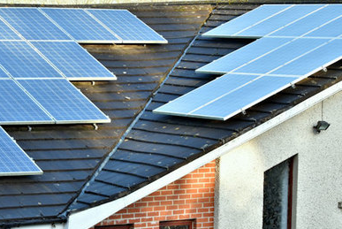
Solar My Roof
Hugh Harford
Joshua Katzenberg
Jack Housego
Ahmed Abbood
Le Wagon London Python Data Science bootcamp #900 April-June 2022

Slide 2

PROBLEM
Climate change is coming on fast
HUGE ramp in renewables needed
Solar generation part of the answer

Slide 3
SOLUTION
Help automate solar installations
Identify roof space suitability with Deep Learning and satellite imagery
Many use cases
Solar My Roof will help us all get solar, faster

Slide 4
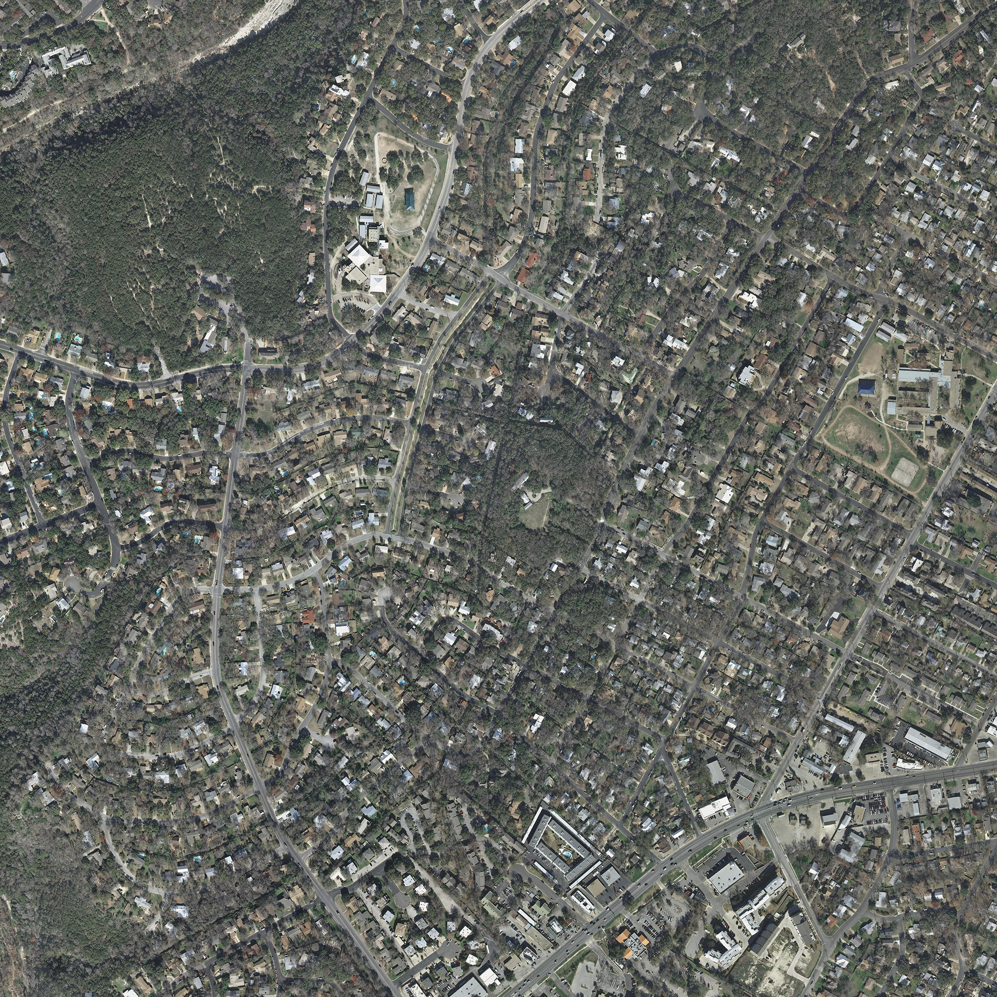

Build a roof detector model
To detect roofs from satellite imagery
Satellite
Target

Slide 5
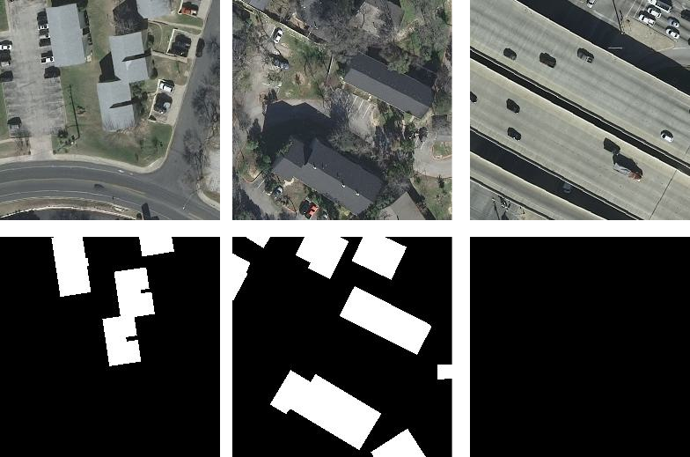
The data
INRIA, a French dataset to help improve CNN ability
180 sets of tif images
(We used 72,000 small ones)
5000 x 5000 pixels
30 cm resolution
5 cities in USA & Europe
Total 405 km²
20 GB of data

Slide 6
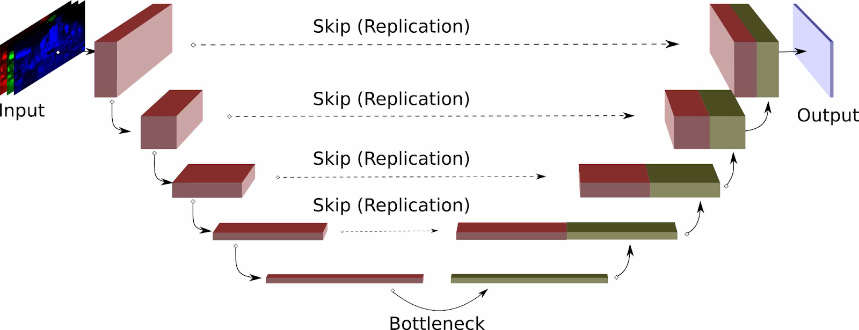

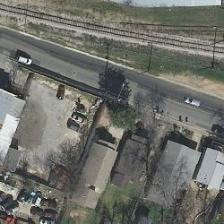

UNet CNN (encoder + decoder)
With transfer learning from VGG-16
Skip connections
Transfer learning:
30 billion images
Bridge

Slide 7
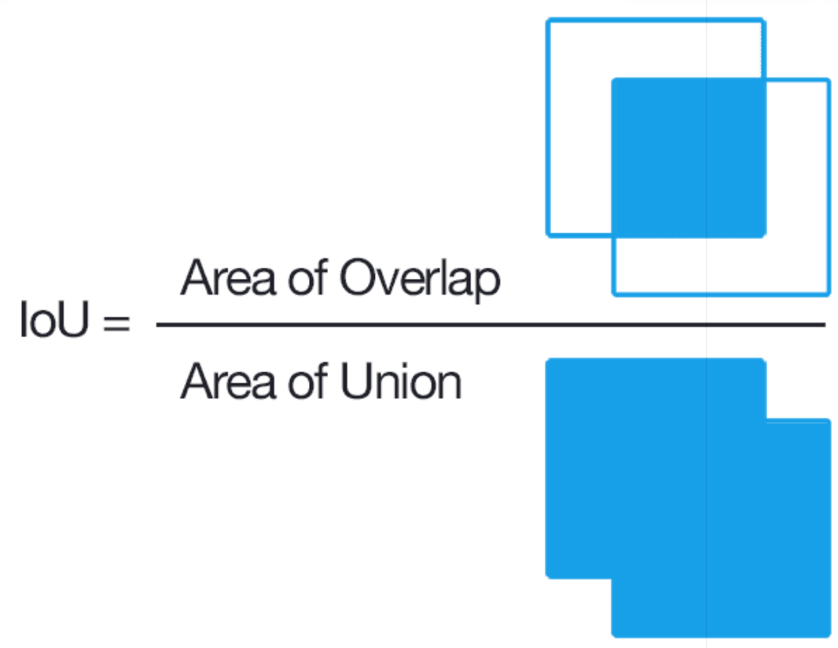
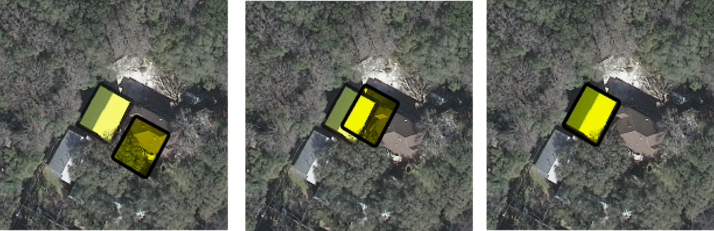
Model performance
We used "Intersection over Union" to drive performance
0%
50%
100%
Improving Intersection
Best means: real target correctly identified and correctly placed

Slide 8
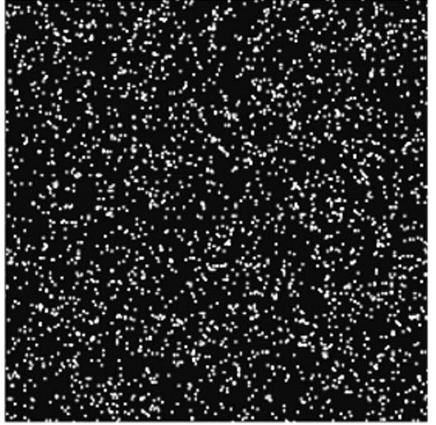
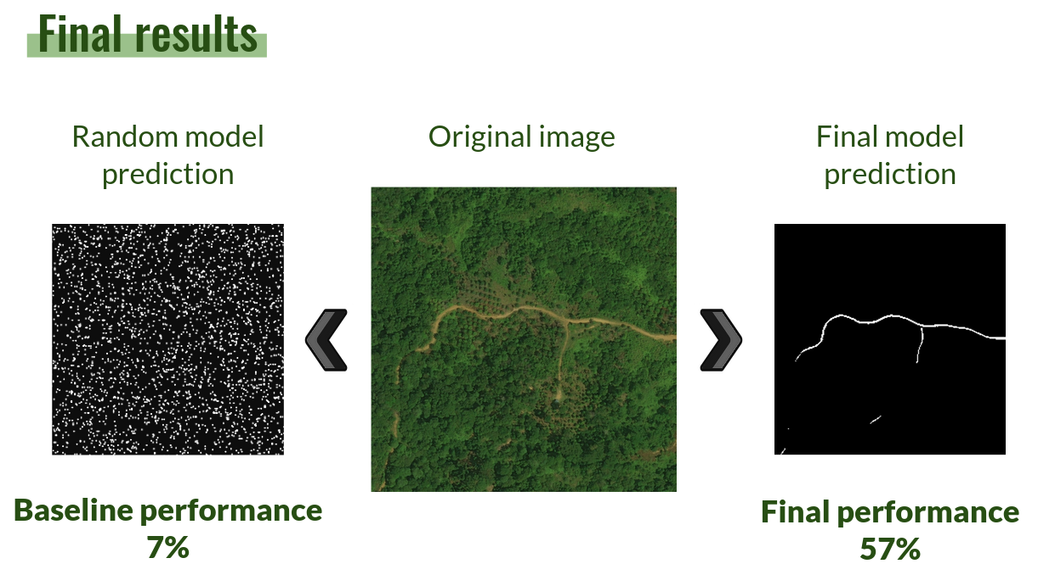
Model performance
Compared with random baseline
Baseline: random noise
Satellite image
Our best prediction
Best binaryIoU: 0.0035
Best Accuracy: 0.0035
Best binaryIoU: 0.627
Best Accuracy: 0.891

Slide 9
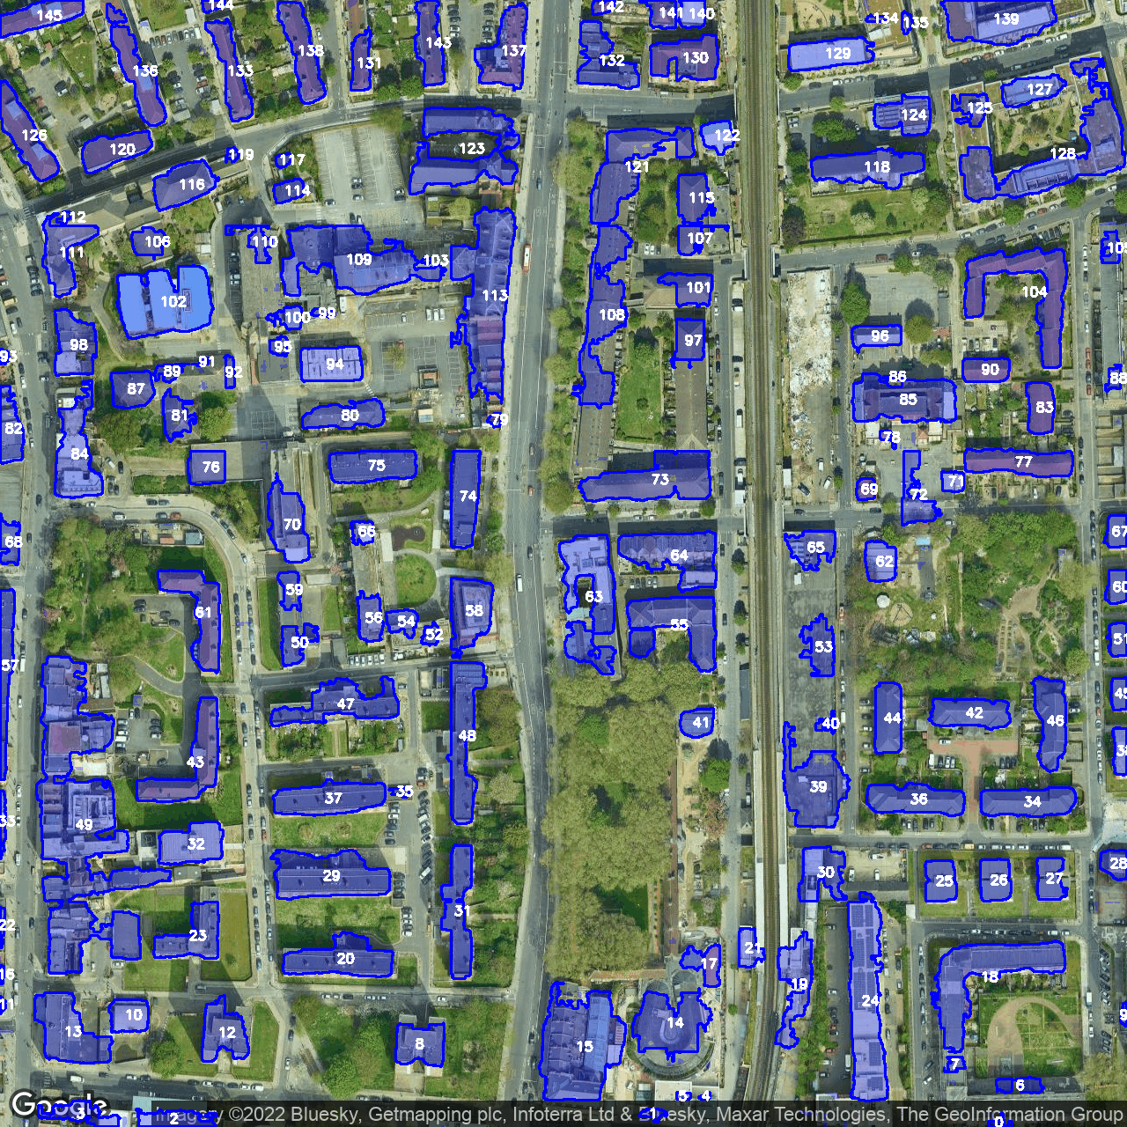

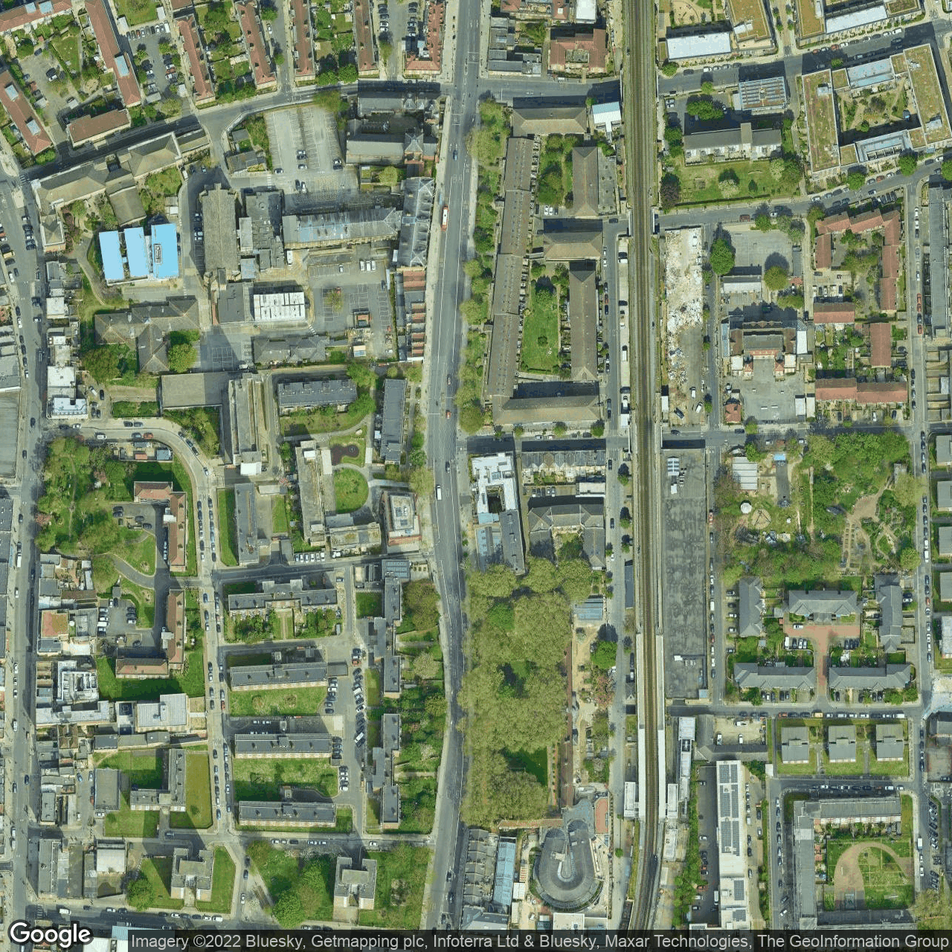
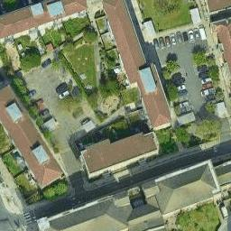
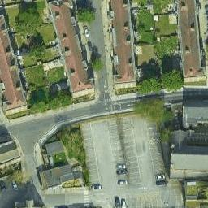
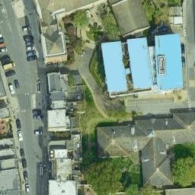




Under the hood
Google Static Maps Satellite API
Overlay with features
UNet at Scale
Predict output mask

Slide 10
Demo time!

Slide 11
Hope you liked!
Any questions?

Slide 12
Overlay with features

Slide 13
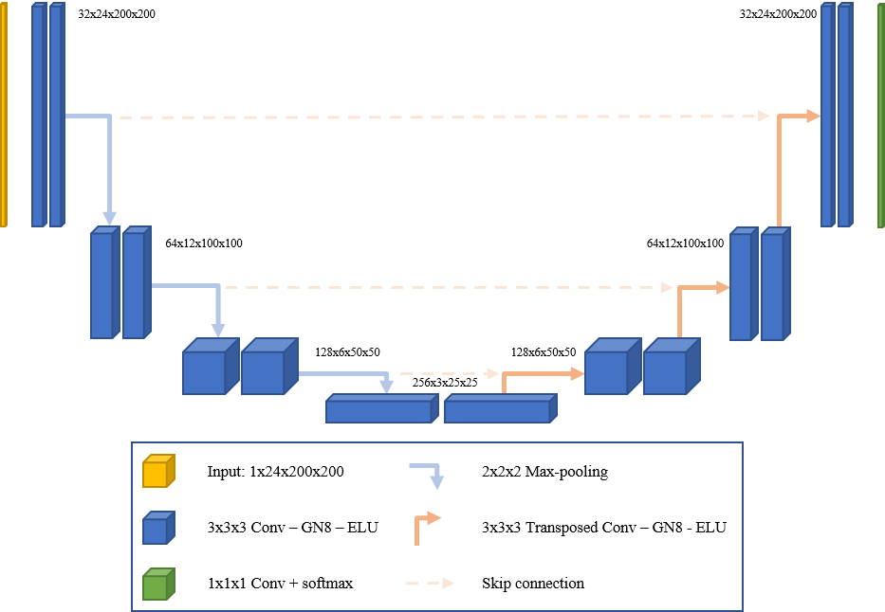

Under the hood
Models and Transfer learning
Running models at scale
outputs
Some unfrozen layers ___
Total params: 25,862,337 Trainable params: 18,223,233 Non-trainable params: 7,639,104

